Slide 1
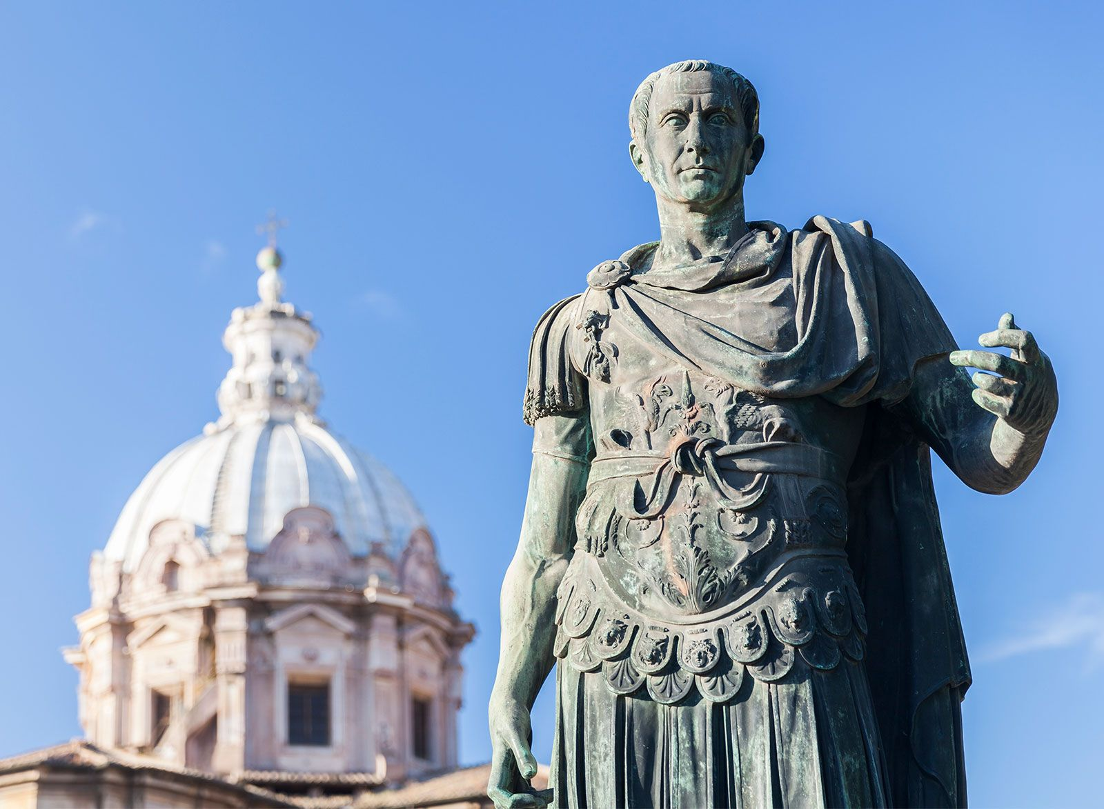
Key Events
- Create a timeline of key dates
BOOK OUT – NO TITLE/GOALS
Week 6 Lesson 1
Ms Barrie

Slide 2
INSTRUCTIONS:
Go to: https://lifeofcaesar.com/timeline-of-the-life-of-gaius-julius-caesar/
Using the key dates provided, create an A3 Timeline of key events from Caesar’s Life
**NOTE: You don’t need to record EVERY date
Timeline Dates: 100 BCE – 44BCE
Categories:
Early Years
Political Ladder
First Triumvirate
Civil War and Ruler of Rome
Assassinated

